Slide 1
Movie Analysis
Team Members:
Jainam Chhadwa
Krupa Shah
Hitaishi Joshi

Slide 2
Introduction
Our project employs PySpark for an in-depth analysis of movie data, with the goal of predicting movie success on IMDB and extracting actionable insights for the film industry.
By leveraging advanced machine learning techniques and graph analysis, our findings aim to benefit a wide range of stakeholders, including filmmakers, producers, distributors, and industry analysts.

Slide 3
Data Description
Dataset is sourced from Kaggle with 3598 records and 28 variables covering diverse aspects of the movie-making process.
Key Variables include
Type | Columns
Categorical | Color, Genres, Language, Country, Content Rating
Numeric | Critic reviews, Duration, Facebook likes (director, actors), Gross revenue, Budget, Year, IMDb metrics
Director and Cast Influence | Director and actor Facebook likes.
Visual Elements and Plot Keywords | Facenumber_in_poster, aspect_ratio, plot_keywords
Temporal | title_year

Slide 4
Data Cleaning and Preprocessing
Imputing
Feature Engineering
Initializing target variable field
Cleaning
Creating a column named IMDB_High with values YES where IMDB score > 7.0
Deleting null values in target variable
Inserted missing values for independent variables
Min-Max Scaling, String Indexer, One Hot Encoder, Vector Assembler

Slide 5
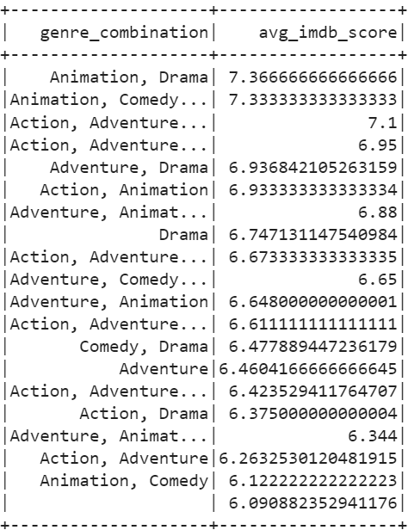
Spark SQL
How can we leverage genre combinations in movie content to maximize audience engagement and IMDB ratings?

Slide 6
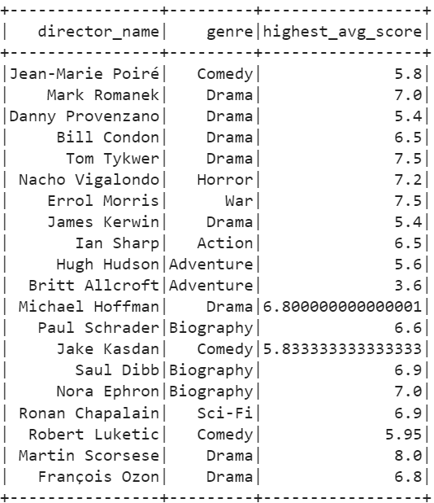
Spark SQL
Optimizing director selection for movie projects based on their genre expertise to enhance success and effectively target audience segments.

Slide 7
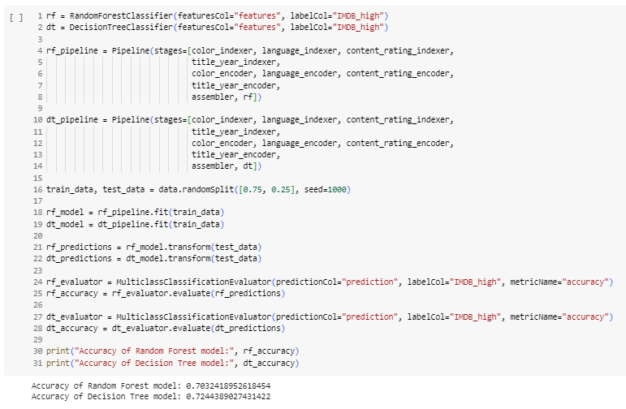
Supervised Learning
Determine if a movie is classified as good or bad as per IMDB score.

Slide 8
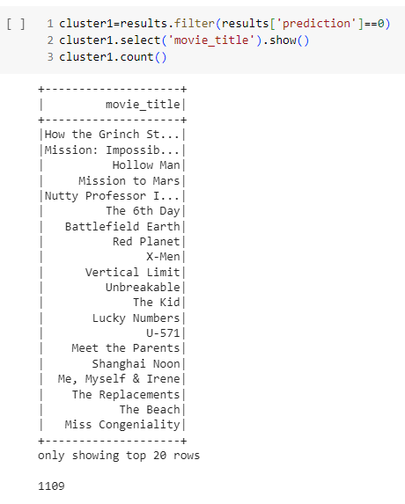
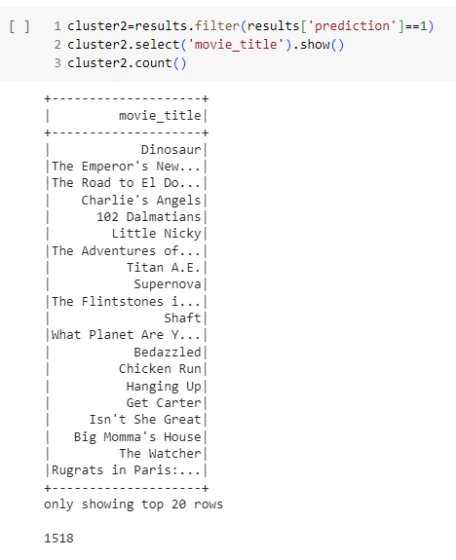
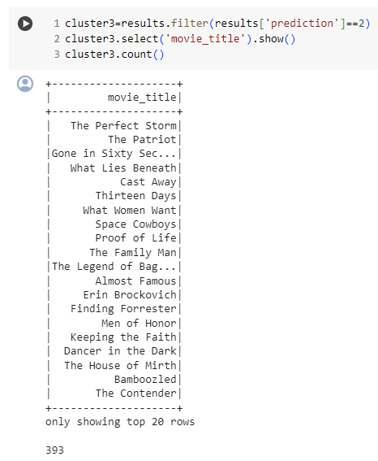
Unsupervised Learning
Determine which movies fall under the same category

Slide 9
Conclusion
Achieved 72.44% predictive accuracy using PySpark-powered supervised learning models for discerning high or low IMDB ratings, empowering industry decisions.
Unveiled collaborative patterns, genre dynamics, and stakeholder interconnectedness, providing actionable insights for filmmakers to optimize production strategies and maximize movie success.

Slide 10
Thank You!

